Slide 1
Sequences and Summations
Computer Science, Purdue University
Copyright McGraw Hill, Rosen, Discrete Mathematics and its Applications

Slide 2
Sequences and Summations
Sequences: Definition
Sequences are ordered lists of elements.
1, 2, 3, 5, 8
1, 3, 9, 27, 81, …….
Sequences arise throughout mathematics, computer science, and in many other disciplines, ranging from botany to music.
We introduce the terminology to represent sequences and sums of the terms in the sequences.
Computer Science, Purdue University

Slide 3
Sequences and Summations
Sequences: Definition
Definition: A sequence is a function from a subset of the integers (usually either the set {0, 1, 2, 3, 4, …..} or {1, 2, 3, 4, ….} ) to a set S.
The notation a_{n} is used to denote the image of the integer n. We can think of a_{n} as the equivalent of f(n) where f is a function from {0,1,2,…..} to S. We call a_{n} a term of the sequence.
Computer Science, Purdue University

Slide 4
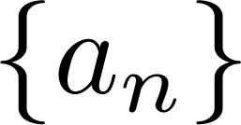
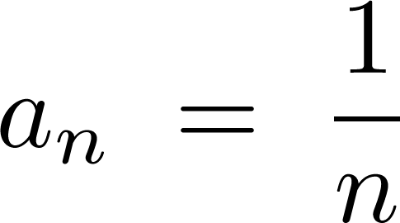
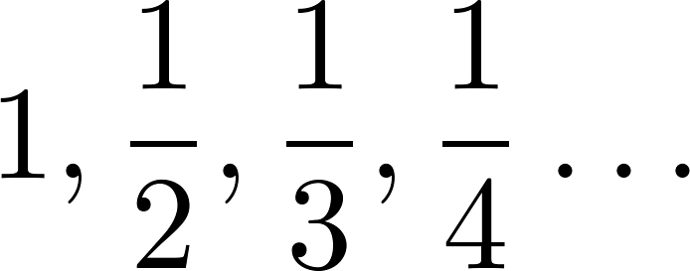
Sequences and Summations
Sequences: Examples
Example: Consider the sequence where

Slide 5
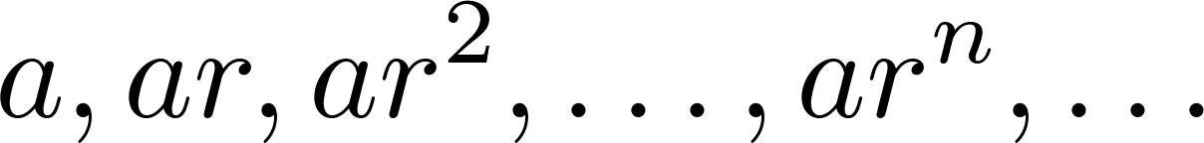
Sequences and Summations
Geometric Progression
Definition: A geometric progression is a sequence of the form:
where the initial term a and the common ratio r are real numbers.
Examples:
Let a = 1 and r = −1. Then:
Let a = 2 and r = 5. Then:
Let a = 6 and r = 1/3. Then:
Computer Science, Purdue University

Slide 6
Sequences and Summations
Arithmetic Progression
Definition: A arithmetic progression is a sequence of the form:
where the initial term a and the common difference d are real numbers.
Examples:
Let a = −1 and d = 4:
Let a = 7 and d = −3:
Let a = 1 and d = 2:
Computer Science, Purdue University

Slide 7
Sequences and Summations
Strings
Definition: A string is a finite sequence of characters from a finite set (an alphabet).
Sequences of characters or bits are important in computer science.
The empty string is represented by λ.
The string abcde has length 5.
Computer Science, Purdue University

Slide 8
Sequences and Summations
Recurrence Relation
Definition: A recurrence relation for the sequence {a_{n}} is an equation that expresses a_{n} in terms of one or more of the previous terms of the sequence, namely, a₀, a₁, …, a_{n-1}, for all integers n with n ≥ n₀, where n₀ is a nonnegative integer.
A sequence is called a solution of a recurrence relation if its terms satisfy the recurrence relation.
The initial conditions for a sequence specify the terms that precede the first term where the recurrence relation takes effect.
Computer Science, Purdue University

Slide 9
Sequences and Summations
Recurrence Relations
Example 1: Let {a_{n}} be a sequence that satisfies the recurrence relation a_{n} = a_{n-1} + 3 for n = 1,2,3,4,…. and suppose that a₀ = 2. What are a₁ , a₂ and a₃?
[Here a₀ = 2 is the initial condition.]
Solution: We see from the recurrence relation that
a₁ = a₀ + 3 = 2 + 3 = 5
a₂ = 5 + 3 = 8
a₃ = 8 + 3 = 11
Computer Science, Purdue University

Slide 10
Sequences and Summations
Recurrence Relations
Example 2: Let {a_{n}} be a sequence that satisfies the recurrence relation a_{n} = a_{n-1} – a_{n-2} for n = 2,3,4,…. and suppose that a₀ = 3 and a₁ = 5. What are a₂ and a₃?
[Here the initial conditions are a₀ = 3 and a₁ = 5. ]
Solution: We see from the recurrence relation that
a₂ = a₁ - a₀ = 5 – 3 = 2
a₃ = a₂ – a₁ = 2 – 5 = –3
Computer Science, Purdue University

Slide 11
Sequences and Summations
Fibonacci Sequence
Definition: Define the Fibonacci sequence, f₀ ,f₁ ,f₂,…, by:
Initial Conditions: f₀ = 0, f₁ = 1
Recurrence Relation: f_{n} = f_{n-1} + f_{n-2}
Example: Find f₂ ,f₃ ,f₄ , f₅ and f₆ .
Answer:
f₂ = f₁ + f₀ = 1 + 0 = 1,
f₃ = f₂ + f₁ = 1 + 1 = 2,
f₄ = f₃ + f₂ = 2 + 1 = 3,
f₅ = f₄ + f₃ = 3 + 2 = 5,
f₆ = f₅ + f₄ = 5 + 3 = 8.
Computer Science, Purdue University

Slide 12
Sequences and Summations
Solving Recurrence Relations
Finding a formula for the nth term of the sequence generated by a recurrence relation is called solving the recurrence relation.
Such a formula is called a closed formula.
Computer Science, Purdue University

Slide 13
Sequences and Summations
Solving Recurrence Relations
Method 1: Working upward, forward substitution
Let {a_{n}} be a sequence that satisfies the recurrence relation a_{n} = a_{n-1} + 3 for n = 2,3,4,…. and suppose that a₁ = 2.
a₂ = 2 + 3
a₃ = (2 + 3) + 3 = 2 + 3 ∙ 2
a₄ = (2 + 2 ∙ 3) + 3 = 2 + 3 ∙ 3
.
.
.
a_{n} = a_{n-1} + 3 = (2 + 3 ∙ (n – 2)) + 3 = 2 + 3(n – 1)
Computer Science, Purdue University

Slide 14
Sequences and Summations
Solving Recurrence Relations
Method 2: Working downward, backward substitution
Let {a_{n}} be a sequence that satisfies the recurrence relation a_{n} = a_{n-1} + 3 for n = 2,3,4,…. and suppose that a₁ = 2.
a_{n} = a_{n-1} + 3
= (a_{n-2} + 3) + 3 = a_{n-2} + 3 ∙ 2
= (a_{n-3} + 3 )+ 3 ∙ 2 = a_{n-3} + 3 ∙ 3
.
.
.
= a₂ + 3(n – 2) = (a₁ + 3) + 3(n – 2) = 2 + 3(n – 1)
Computer Science, Purdue University

Slide 15
Thank You

